Slide 1
C++ Programming(Exercise) 6
Arne Kutzner
Hanyang University / Seoul Korea

Slide 2
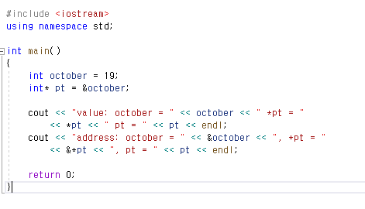
Pointers

Slide 3
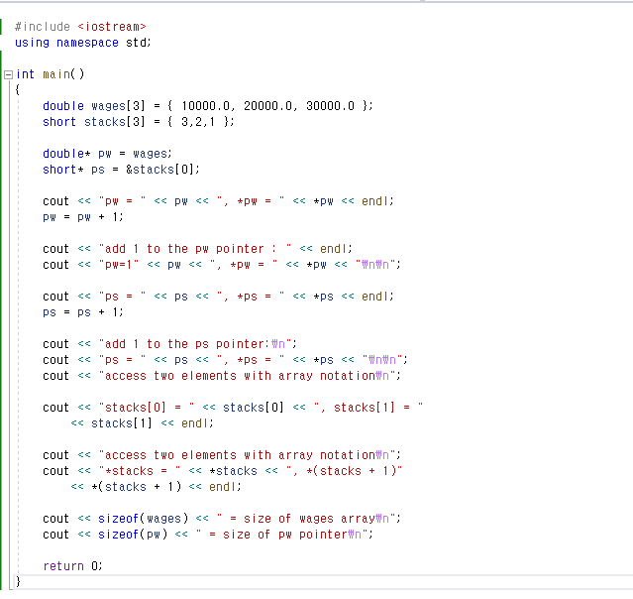
Pointer Addition

Slide 4
C++ strings
String: null terminated array of characters
null terminated: A character at the end of the array has the value 0(null).

Slide 5
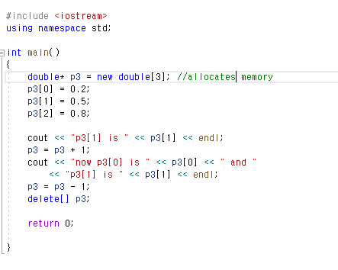
New &Delete

Slide 6
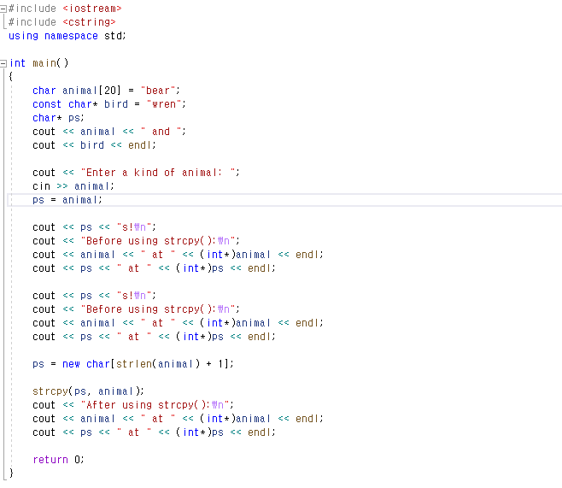
pointers to strings

Slide 7
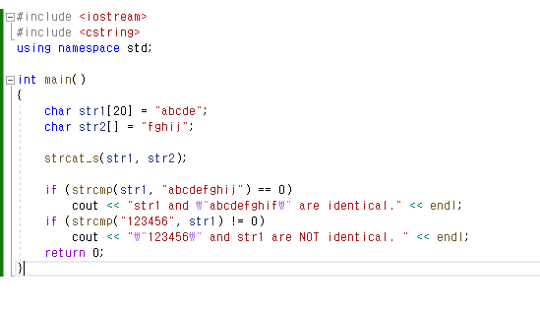
strcat & strcmp

Slide 8
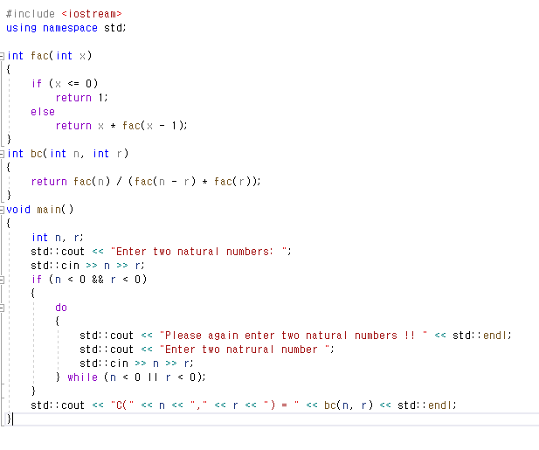
HW Solution 2-1

Slide 9
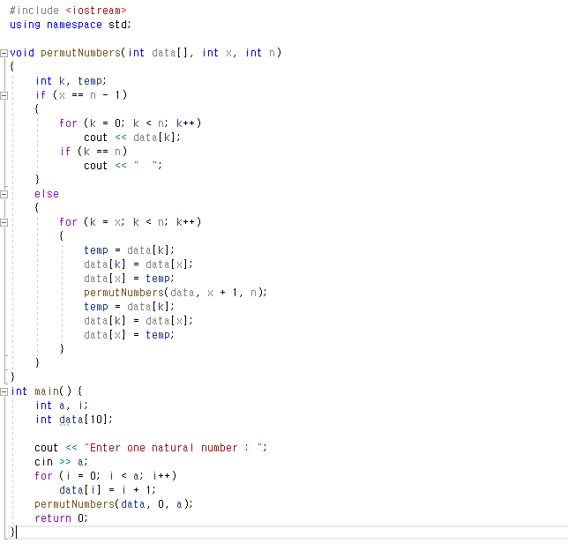
HW solution 2-2

